Slide 1
Team Members
Seema Hegde
Dharmi Mehta
Thanyaporn Techangam
Team: 22893
Phoenix Suns

Slide 2

Lego Project

Slide 3

Introducing our lego car!

Slide 4
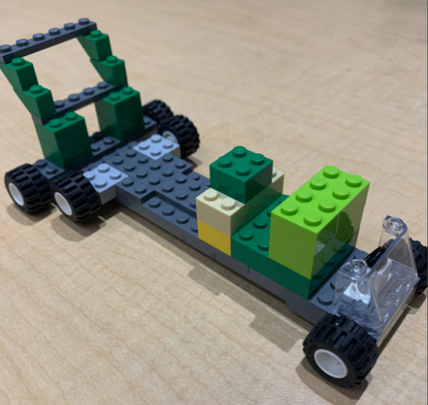
Lego Car Model

Slide 5
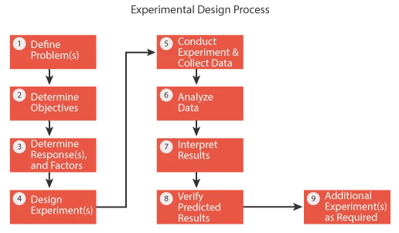

Slide 6

Table of Content
1
2
4
5
Identify process
inputs (Xs) that might affect the
output
Timeline
Summary
Objective and Goal

Slide 7

Objective and Goal for this project
Apart from having fun and compiling the prototype of the car which can go the furthest, we also want to explore how to conduct a design of experiment to figure out the best factors and level combinations that can help us achieve both understanding and satisfaction!

Slide 8

Experiment setup
How you conducted the experiment and where?
Trying to come up with a car based on preferred design
(3 prototypes in total)
Creating a ramp from cardboard and adjusting it at an angle of
30 degrees and fix it to the wall and table for a standard setup
Running each prototype and seeing which one goes the furthest
Selecting the winning prototype and coming up with factors we can change that will be our top 4 most impactful factors
Trying to change each factor using ‘The One Half Fraction of the 2^{k} Design’ concept and table (selected the principle fraction with I=+ABCD)
Measuring the distance of each run with 3 replications. Each replicate contains 8 runs (from 2^k-1→ 2^4-1= 2^3= 8)
NOTE: we conducted the experiment in a meeting room at Mccord hall

Slide 9
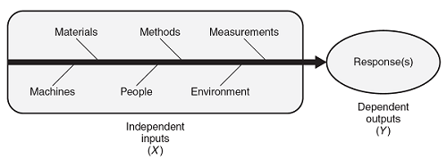
Figuring out what is our y
Such as the width in front of the car, Wheel size,
Number of Wheels, Aerodynamic distribution and Wheelbase and so-on

Slide 10
Response variable (y) is the distance, the further the better!
“
We measured the distance travelled by the car from the ramp to the point where it came to a standstill.
”

Slide 11
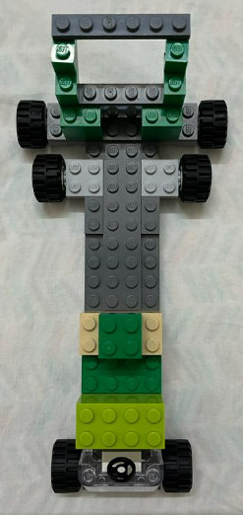
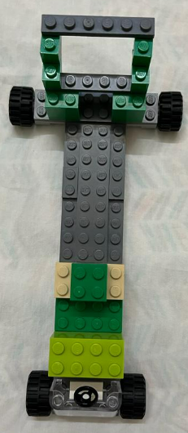
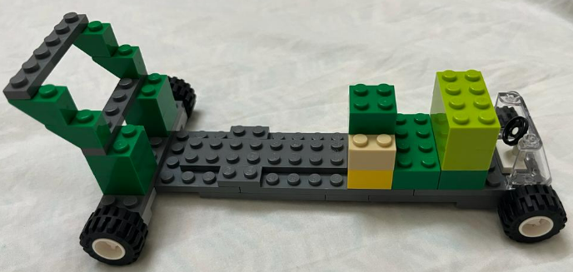
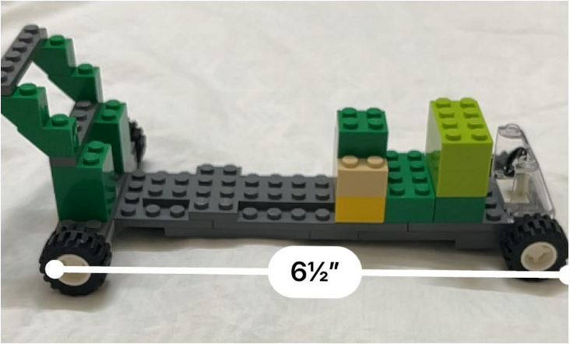
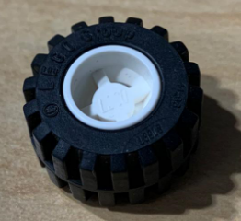
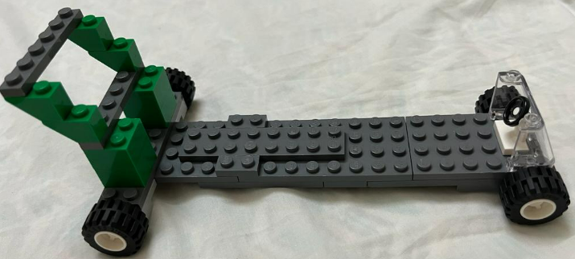
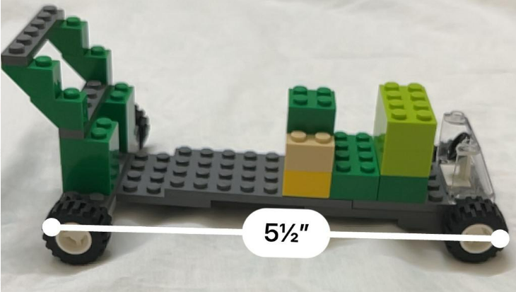
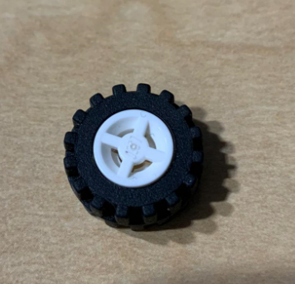
Factors chosen & Description
A. Wheel size
B. Number of Wheels
C. Aerodynamic distribution
D. Wheelbase
Chief Operations Officer
6.5” Long (1) vs 5.5” Short(-1)
Big (1) vs Small (-1)
6 (1) vs 4 (-1)
Yes (1) vs No(-1)
VP Marketing
Add weight in front of the car or not
Increase length of car

Slide 12
Thought process behind factor selection
The wheel size could have an impact on the speed , assumption is that bigger wheels will help gain top speed
Wheelbase contributes to the stability of the car. Longer the length of the car, more stable at higher speed
Adding another pair of wheels adds to the weight that pulls the car down to increase speed and eventually distance travelled
Weight distribution, even in a normal car the heaviest part containing the engine is present in the front end

Slide 13
How to block Noise (uncontrollable variables)
1.
2.
3.
Testing on the table instead of the floor which increased the friction due to the carpet. This uncontrollable input was affecting the response variable (resulting in shorter distance)
Testing in a closed environment (like a meeting room) as the factors like air flow can be controlled as opposed to the outside where the impact of wind sabotages our ramp / the distance travelled.
To keep the ramp and the angle ( 30 degrees ) intact, attach the ramp to a surface by tape. This will prevent unbalanced ramp to help stabilized out the results.

Slide 15






Steps
to Design our experiment
Plan and Collect Data (all distance from 24 runs)
Run in minitab
Identify all significant factors
Refine model and re-run it in minitab
Interpret the results

Slide 16
Fractional Factorial Design
Design Summary
Factors: 4 Base Design: 4, 8 Resolution: IV
Runs: 24 Replicates: 3 Fraction: 1/2
Blocks: 1 Center pts (total): 0
Design Generators: D = ABC
Alias Structure
I + ABCD
A + BCD
B + ACD
C + ABD
D + ABC
AB + CD
AC + BD
AD + BC
Step 0:
creating random order in minitab to deal with uncontrollable variables

Slide 17
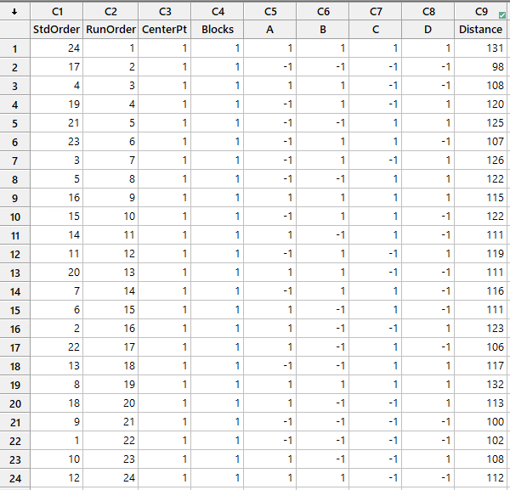
1 :
After collecting 24 distances from 3 replications, we randomly assigned them into each order based on principal fraction I=+ABCD

Slide 18
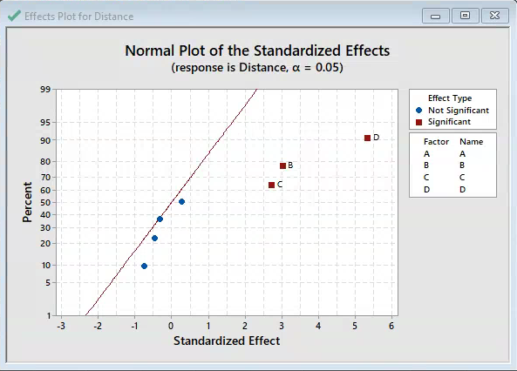
2 :
Analyzing the Normal Plot,
we found that only 3 factors which are Number of Wheels (B), Aerodynamic distribution(C) and Wheelbase(D) are statistically significant.
NOTE: We still have the alias of B= +ACD, C=+ABD and D= +ABC but we can ignore these higher order interactions due to the sparsity effect!

Slide 19
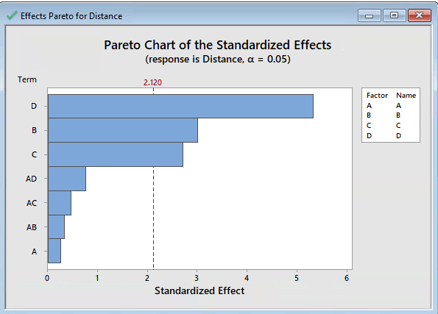
2 (contd.):
Same results with Pareto chart that the factors which are statistically significant are B, C and D!

Slide 20
Analysis of Variance
Source DF Adj SS Adj MS F-Value P-Value
Model 7 1452.62 207.518 6.54 0.001
Linear 4 1423.83 355.958 11.23 0.000
A 1 2.042 2.042 0.06 0.803
B 1 287.04 287.042 9.05 0.008
C 1 234.38 234.375 7.39 0.015
D 1 900.38 900.375 28.40 0.000
2-Way 3 28.79 9.597 0.30 0.823
Interactions
A*B 1 3.38 3.375 0.11 0.748
A*C 1 7.04 7.042 0.22 0.644
A*D 1 18.38 18.375 0.58 0.458
Error 16 507.33 31.708
Total 23 1959.96
2 (CONT.):
Confirmed by ANOVA table that
Only B, C and D are statistical significance by having P-Value< 0.05 at 95% confidence level!!

Slide 21
Model Summary
S R-sq R-sq(adj) R-sq(pred)
5.63102 74.12% 62.79% 41.76%
3 : Checking the Model Summary
With Adjusted R-squared= 62.79% and predicted R-squared = 41.76% which is less than R-squared value,
Therefore, we will try to drop factors with P-Value> 0.05 to understand if this will improve the model performance further.

Slide 22
Coded Coefficients
Term Effect Coef SE Coef T-Value P-Value VIF
Constant 114.79 1.15 99.87 0.000
A 0.58 0.29 1.15 0.25 0.803 1.00
B 6.92 3.46 1.15 3.01 0.008 1.00
C 6.25 3.12 1.15 2.72 0.015 1.00
D 12.25 6.13 1.15 5.33 0.000 1.00
A*B -0.75 -0.38 1.15 -0.33 0.748 1.00
A*C -1.08 -0.54 1.15 -0.47 0.644 1.00
A*D -1.75 -0.88 1.15 -0.76 0.458 1.00
Coefficient table &
Regression equation
Regression Equation in Uncoded Units
Distance = 114.79 + 0.29 A + 3.46 B + 3.12 C + 6.13 D - 0.38 A*B - 0.54 A*C - 0.88 A*D

Slide 23
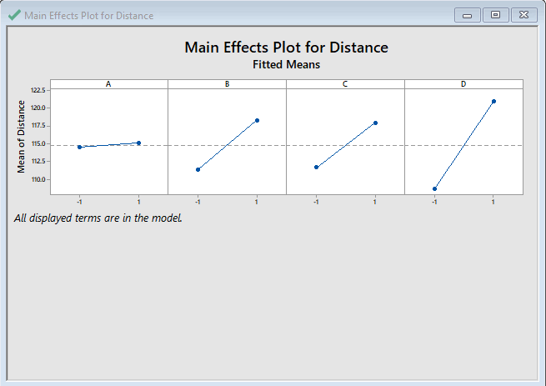
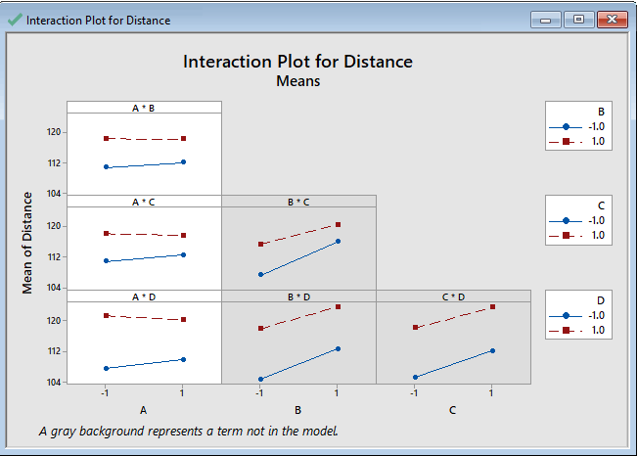
NO interaction between any factors! So there is no flipping results.
From the Main Effects Plot, we can see that the factor which seems to impact our car distance the most is factor D or ‘ Wheelbase’ which we have to maintain at high level!, Number of wheels (B) and Aerodynamic distribution (C) are also impacting. But, the wheel size (A) seems to have no impact

Slide 24
Fits and Diagnostics for Unusual Observations
Obs Distance Fit Resid Std Resid
9 115.00 126.00 -11.00 -2.39 R
R Large residual
Warning! Seems like we have found a potential outlier which is observation #9 with a distance of 115 cm. However, we investigated and tried running it again to measure the distance. Turns out we still get approximately the same value. Therefore, we considered that it was not a wrong measurement and decided to keep it in our model

Slide 25
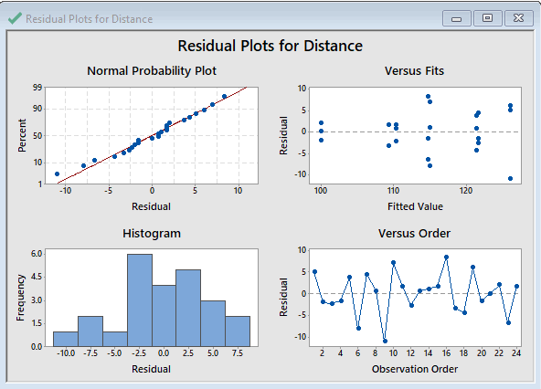
4. Residual Plots
Verify NID assumption!
For Normality assumption: According to the Normal Probability Plot, our model seems to pass the fat pencil test by having all data fitted in the line.
For Constant variance: According to the Versus Fits, it seems that there is a problem as it seems to have a funnel look alike
For Independent variance:
According to the Versus Order, there is no problem with it. No pattern occurred. So we conclude that there is no problem with this assumption.

Slide 26
REFINED MODEL
Excluding A and all 2-factor interactions
Considering only the significant factors from ANOVA and re-running the DOE factorial analysis.

Slide 27
Analysis of Variance
Source DF Adj SS Adj MS F-Value P-Value
Model 3 1421.79 473.931 17.61 0.000
Linear 3 1421.79 473.931 17.61 0.000
B 1 287.04 287.042 10.67 0.004
C 1 234.37 234.375 8.71 0.008
D 1 900.37 900.375 33.46 0.000
Error 20 538.17 26.908
Lack-of-Fit 4 30.83 7.708 0.24 0.910
Pure Error 16 507.33 31.708
Total 23 1959.96
1. We have only retained the factors that are statistically significant to our response variable
(P-Value< 0.05 at 95% confidence level!)
2. The R-sq value decreased as we reduced the number of factors in this run.
The inclusion of important input variables has improved the R-sq(aj). The predictability of the model has also increased.
Model Summary
S R-sq R-sq(adj) R-sq(pred)
5.18732 72.54% 68.42% 60.46%

Slide 28
Coded Coefficients
Term Effect Coef SE Coef T-Value P-Value VIF
Constant 114.79 1.06 108.41 0.000
B 6.92 3.46 1.06 3.27 0.004 1.00
C 6.25 3.12 1.06 2.95 0.008 1.00
D 12.25 6.12 1.06 5.78 0.000 1.00
3.
The regression equation changes and we are able to quantify the effect of each factor in the coded coefficients table
Regression Equation in Uncoded Units
Distance = 114.79 + 3.46 B + 3.12 C + 6.12 D

Slide 29
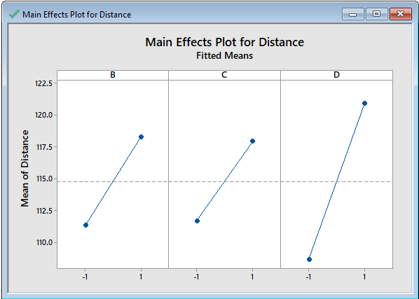
4.
The main effects plot shows the levels at which the factors
should be set in order to maximize the distance .
Here, we will set the Number of Wheels (B), Aerodynamic distribution(C) and Wheelbase(D) all at a high.

Slide 30
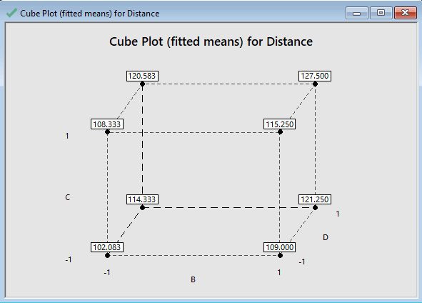
The Cube Plot is also used to understand the factor levels for maximum response output with quantifiable fitted means for distance. Therefore, we can conclude that the high level of Wheelbase (D) is what impact our car distance the most

Slide 31
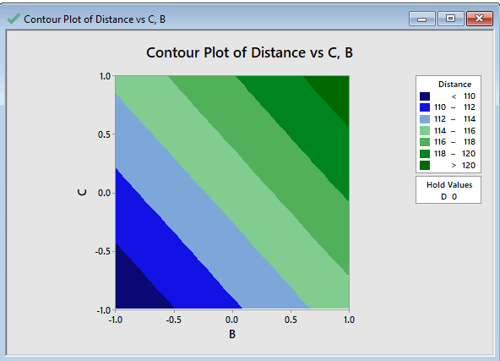
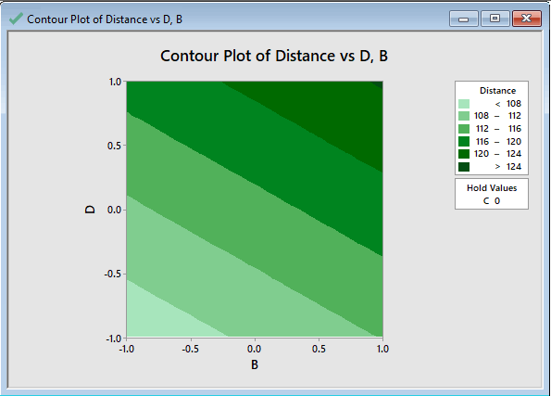
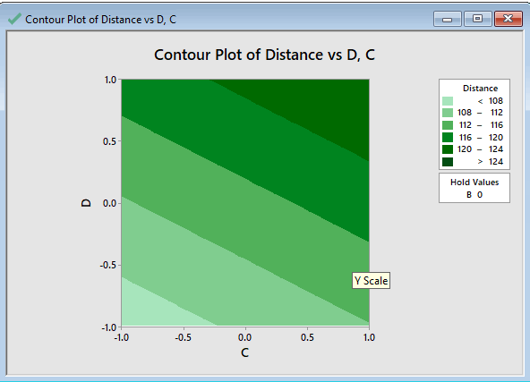
Contour Plots
The darker regions in this graph indicate higher distances. Combination of any of the factors B or C
with D ( wheelbase) gives the maximum response.

Slide 32
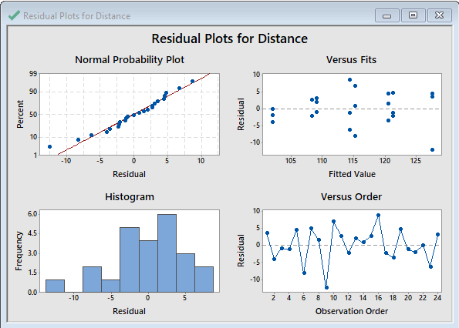
5. Residual Plots
For Normality: Our model seems to pass the fat pencil test with most of the data points fitted on the line.
For Constant variance: The spread of data has improved. it is random and more towards constant variance.
For Independence :
We do not see any pattern in the observation order and can say that the residuals are independent.

Slide 33
FINANCIAL ANALYSIS
Analyzing the total cost of each part and the upper & lower factors of our lego car and how we combined the base and weight with all the lego items.

Slide 34
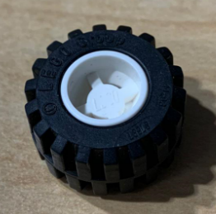

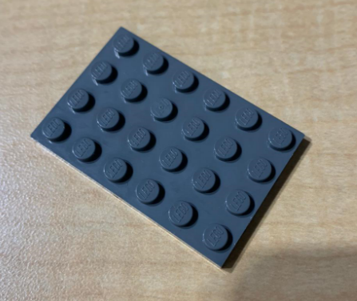

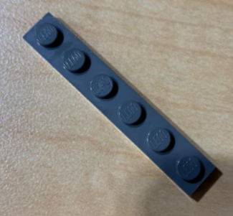




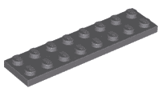
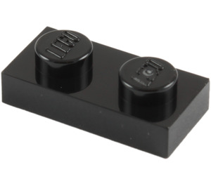


Slide 35
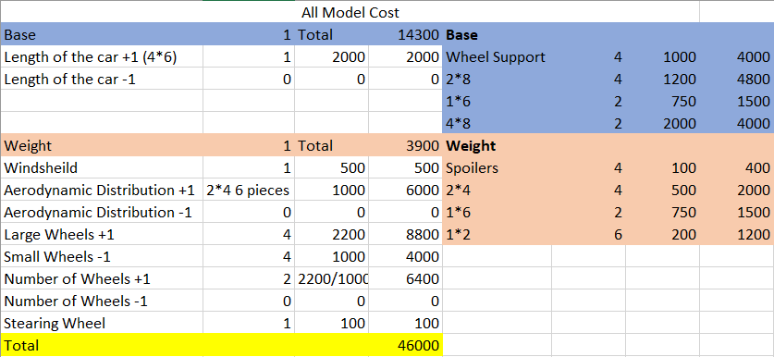
Financial Analysis

Slide 36
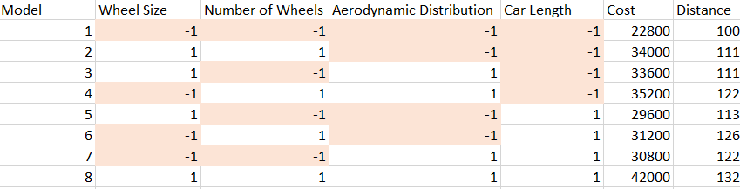
Cost with 4 different levels of factors
The table besides shows the total cost with 4 different level factors of all 8 models. As we can see our cost varies from 22800 to 42000. This major change in the cost is due to addition of weights to adjust the aerodynamic distribution and changing the size of wheels used.

Slide 37
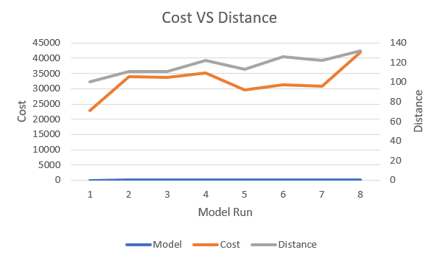
The result of all models’ cost difference is because we spend much on weight adjusting the aerodynamic distribution and changing the size and number of wheels. If there is further experiment, this factor may be changed to whether to place weight on the car and place more price gaps on other factors to achieve the financial purpose.

Slide 38
Conclusion & Recommendations
In this DOE experiment, we found the aerodynamic distribution, length of the car and number of wheels have a major effect on the distance and speed of the car.
We recommend…
From our experiment, we interpret the wheel size does not make a huge difference. Thus we can use smaller wheel size which would cut our cost.
We can run experiments on how much weight to include to maintain proper centre of gravity and aerodynamic distribution.
Factor like axle length can also be taken into consideration and experiments can be run to check if the car goes any further.

Slide 39
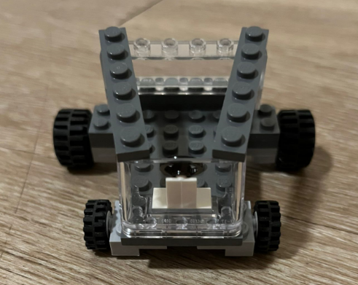
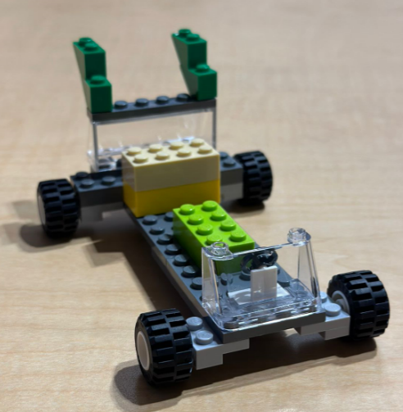
Appendix:
These are the 2 prototypes we created but did not select for DOE

